Slide 1
DT 228-1 and DT282-1 Computer Architecture and Technology
Tutorial 6

Slide 2
Von Neumann Architecture
Q: Why does the von Neumann architecture endure?
A: Apart from the fact that hardware has been incrementally improved but its modality has remained in relation to the form of ‘processor’, the general ‘computer system’ needs ORDER and PRECISION, and the von Neumann architecture provides that.

Slide 3
Von Neumann Model

Slide 4
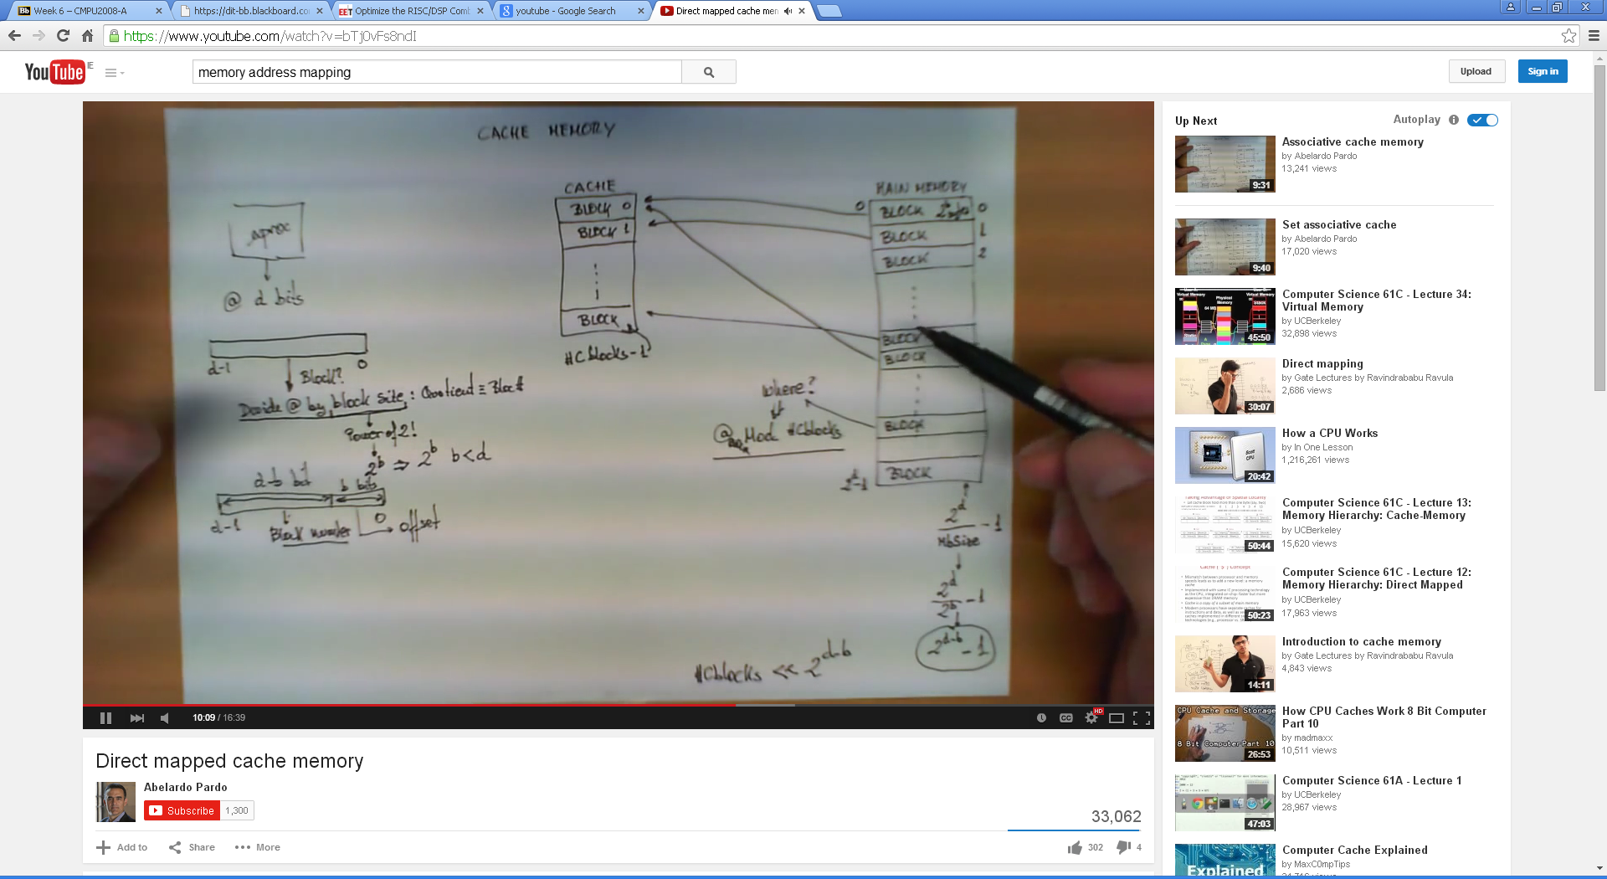
Memory Addressing Example
Here is that Youtube clip on Memory Addressing again!
https://www.youtube.com/watch?v=bTj0vFs8ndI

Slide 5
The Instruction
The instruction is the fundamental unit of work in a computer.
An instruction specifies two things:
opcode: the operation to be performed
operands: the data/locations to be used for operation
An instruction is encoded as a sequence of bits, just like data!
Often, but not always, instructions have a fixed length, such as 16 or 32 bits.
The Control Unit interprets the instruction: generates a sequence of control signals to carry out the operation.
The operation is either executed completely, or not at all.
A computer’s instructions and their formats is known as its Instruction Set Architecture (ISA).

Slide 6
Instructions and the Clock
The clock signal that keeps the control unit moving.
At each clock “tick” the control unit moves to the next machine cycle – which may be next instruction or next phase of current instruction.
Clock generator circuit:
Based on crystal oscillator
Generates regular sequence of “0” and “1” logic levels
Clock cycle (or machine cycle) - rising edge to rising edge
“1”
“0”
Machine
Cycle
time→

Slide 7
Typical Exam (Sub) Question For This Content
Question
What is the practical principle of ‘memory mapping’ in relation to a microprocessor?
Sample solution
The speed at which application instructions are processed on a system is proportionate to the number of access operations required to obtain data outside of program-addressable memory.
The system provides two methods for reducing the transactional overhead associated with these external read and write operations. You can map file data into the process address space.
You can also map processes to anonymous memory regions that may be shared by cooperating processes.

Slide 8
Solution continued
Memory mapped files provide a mechanism for a process to access files by directly incorporating file data into the process address space. The use of mapped files can significantly reduce I/O data movement since the file data does not have to be copied into process data buffers, as is done by the read and write subroutines.
When more than one process maps the same file, its contents are shared among them, providing a low-overhead mechanism by which processes can synchronise and communicate.
Mapped memory regions, also called shared memory areas, can serve as a large pool for exchanging data among processes. The available subroutines do not provide locks or access control among the processes. Therefore, processes using shared memory areas must set up a signal or semaphore control method to prevent access conflicts and to keep one process from changing data that another is using.

Slide 9
Solution continued
Shared memory areas can be most beneficial when the amount of data to be exchanged between processes is too large to transfer with messages, or when many processes maintain a common large database.
The system provides two methods for mapping files and anonymous memory regions.
(10 marks)

